Slide 1
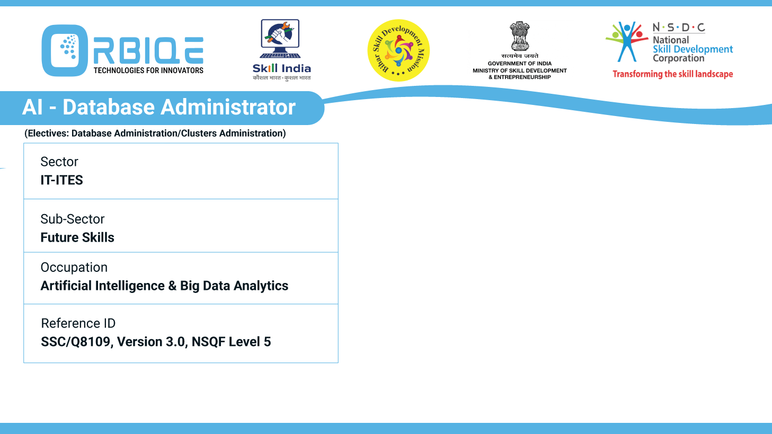
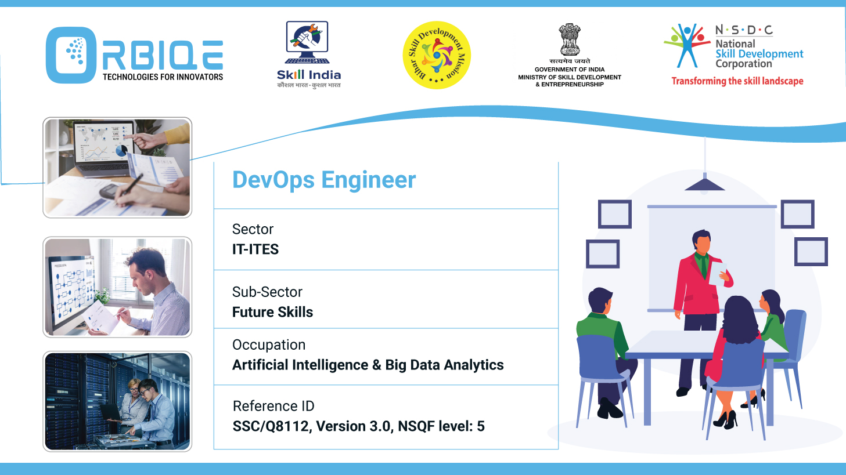
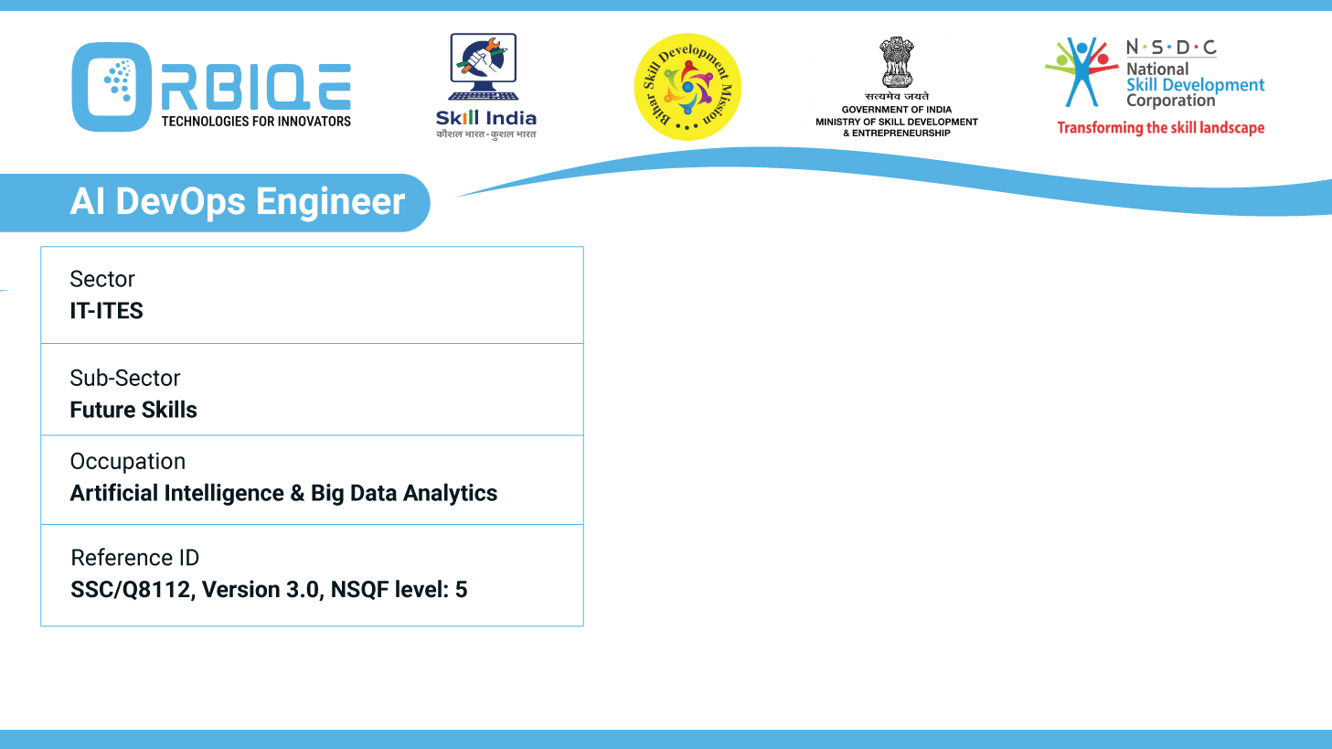
Name- Krishna Kant Dubey

Slide 2

Database Birth: Installation and Creation Demystified

Slide 3
Agenda
Demonstrate the process of installing and creating new databases, providing hands-on experience in establishing the foundation for efficient data management in AI Database Administration

Slide 4
Step-by-Step: Installing and Creating Databases for AI Workloads
Choose Your Database Platform
Install the Database Engine
Create a New Database
Enable AI Features
Load Sample Data
Validate and Optimize

Slide 5
Install the Database Engine
For Oracle Database:
Getting Started with Oracle Select AI - generative AI and your database explains how Oracle Select AI integrates with your database and guides you through setup and configuration for AI-driven querying.
For SQL Server:
Use the SQL Server Installer or Docker image.
Configure instance settings, authentication mode, and storage paths.
For MongoDB:
Download from mongodb.com.
Use mongod to start the server and mongo shell to interact.

Slide 6
Enable AI Features
Use AI extensions or built-in tools:
Oracle 23ai includes AI vector search, SQL firewall, and GoldenGate AI for replication.
SQL Server 2025 supports semantic search, automatic tuning, and predictive indexing.

Slide 7
Load Sample Data
Use structured or unstructured datasets:
CSVs, JSON, or real-time streams
Use ETL tools or scripts to ingest data
Example (PostgreSQL):
COPY ai_data.users FROM '/path/to/users.csv' DELIMITER ',' CSV HEADER;

Slide 8
Validate and Optimize
Run test queries to validate schema and indexing
Use AI tools to monitor performance and detect anomalies
Automate backups and indexing for long-term efficiency

Slide 9
Thank You

